Slide 1

Chargeback Gurus – Technical Presentation
Date: 22-11-2020
Presenter: Monisha Anila

Slide 2
The formation SMART problem statement and it’s problem solving methods.
What opportunities exists for client’s car company after seeing revenue increase by 20% 2003(Q2) – 2005(Q2) to bring revenue gains by 50% at the end of 2006(Q2) through new product and delivery strategy or closing stores
at low revenue?
Descriptive Statistics
Inferential Statistics
Source: Car client (2003-2005) financial year $ value

Slide 3
Cost pressures can be alleviated through the proactive identification of customer demands, with expected decrease in product and delivery issues up to 0% by the end of 2006.
!
Increased demand on cars leading to more car warehouse optimization
Unoptimized car warehouse lead to 20% sales down
!
Identify car sales variables which are correlated for car warehouse?
Analyse given variables using statistics to form correlation matrix
!
By framing linear equation to identify car warehouse dependent variables on car sales can we apply to other stores?
When we identify dependent variables on car sales we can scale it to other stores.
Source: Car client (2003-2005) financial year $ value

Slide 4
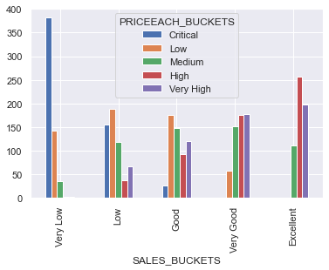
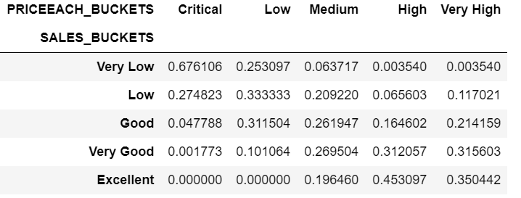
While doing customer segmentation based on sales and price. We found out almost revenue and price are directly proportional according to their bucket range.
Key Insights
Source: Car client (2003-2005) financial year $ value

Slide 5
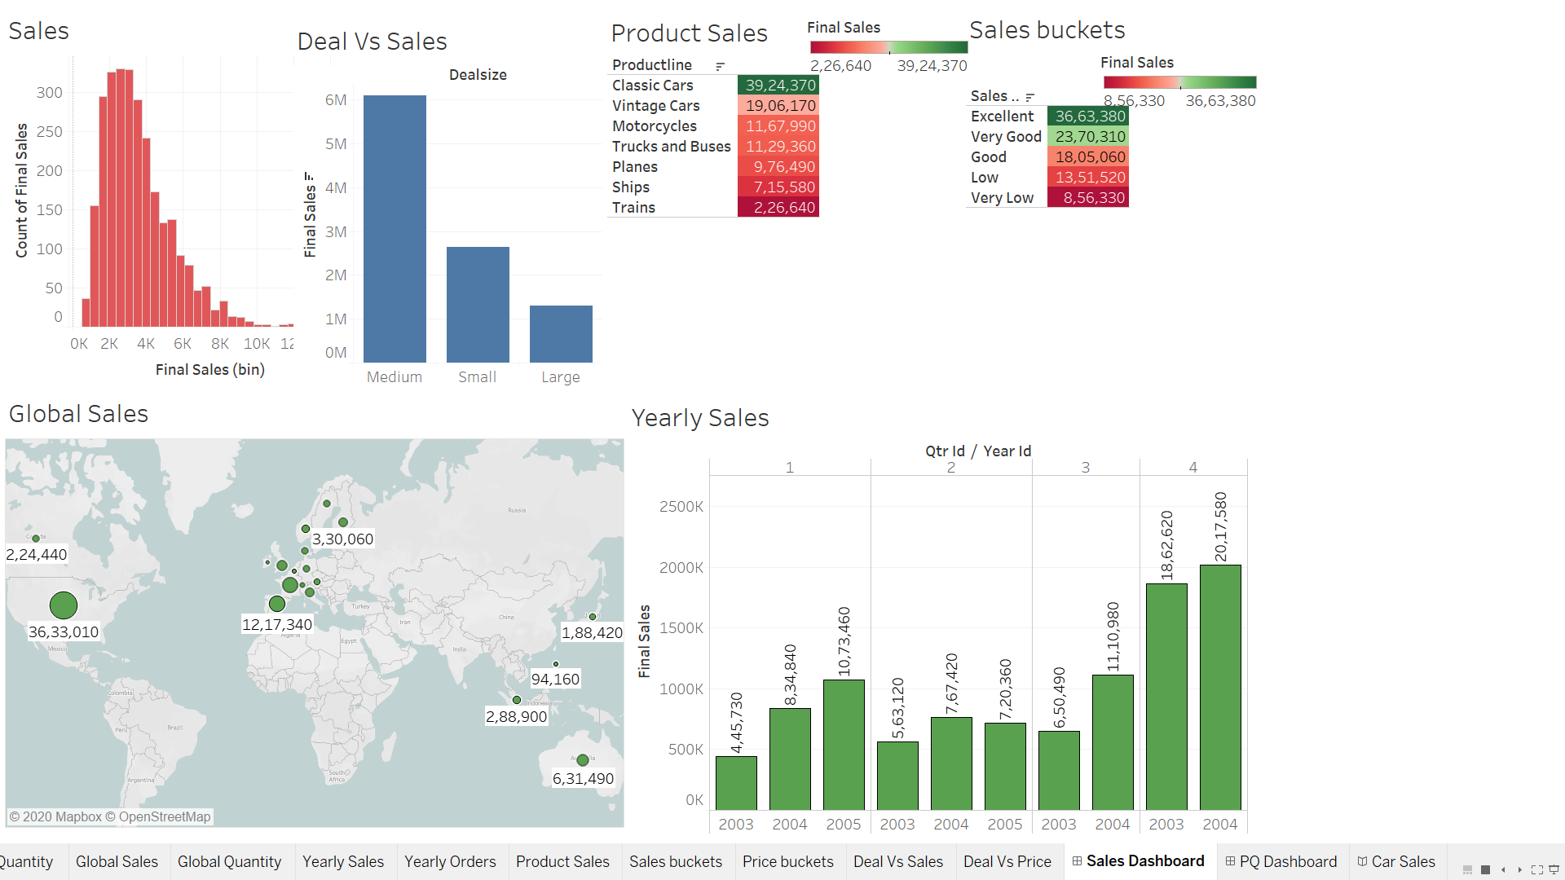
Sales distribution and it’s EDA analysis on deal, buckets, year and Global impact.
Key Insights
Sales not in normal distribution and almost medium deals are profitable. Most sales are classic cars and excellent bucket is 10% high on very good bucket .
Most sales are from USA and Spain. Revenue is 20% higher from previous Q2 sales of 2004.
Source: Car client (2003-2005) financial year $ value

Slide 6
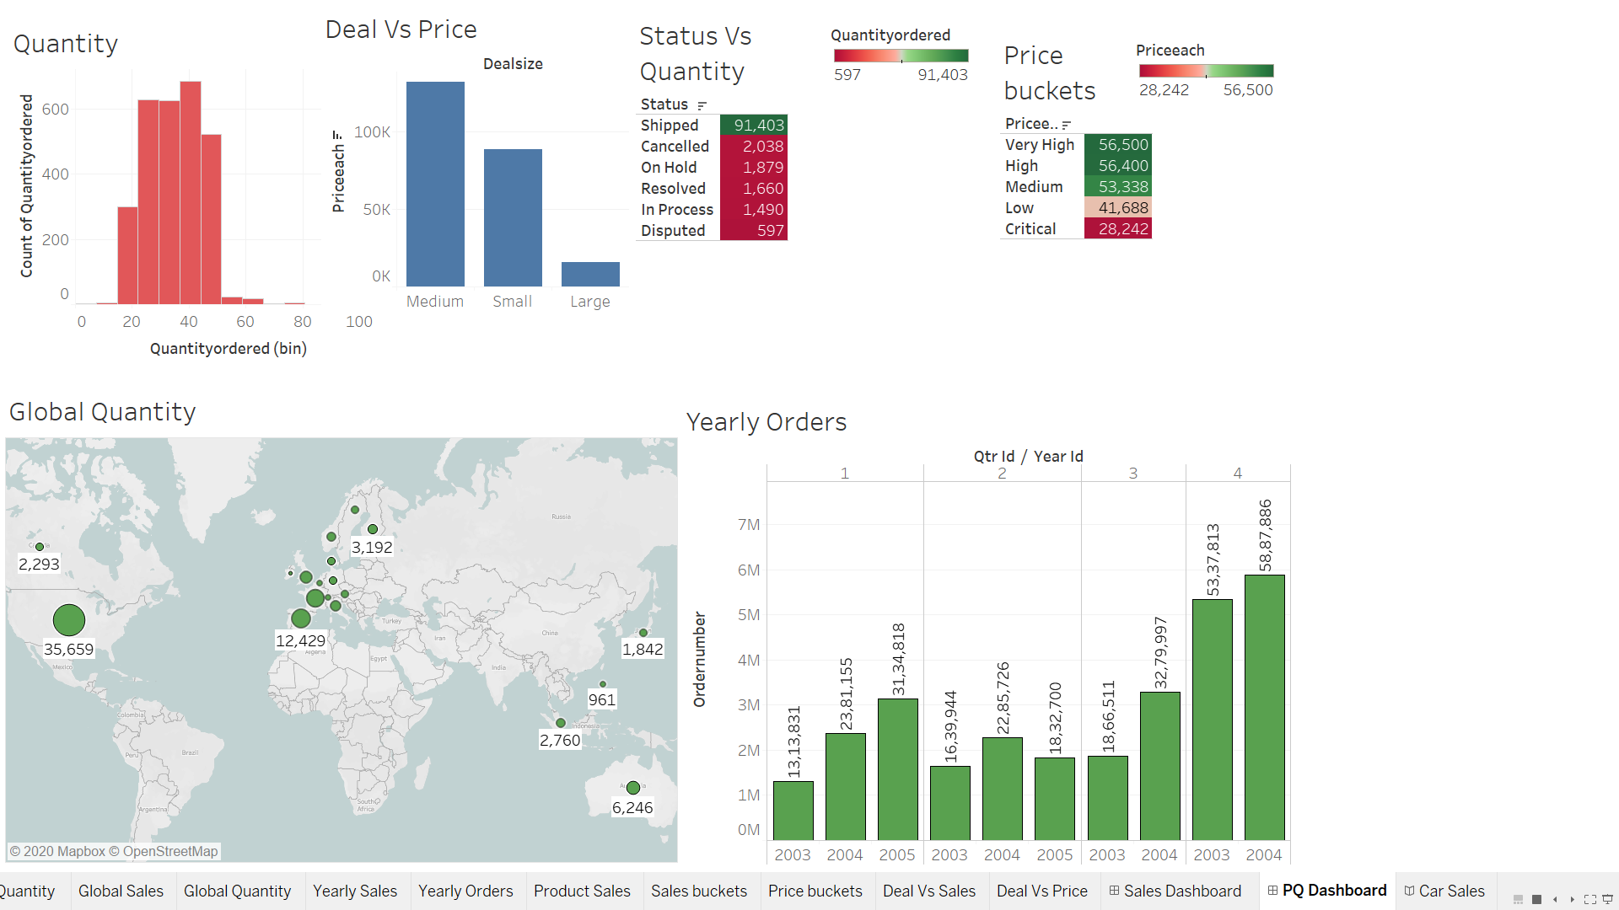
Quantity and Price distribution and it’s EDA analysis on deal, status, buckets, year and Global impact.
Key Insights
Quantity not in normal distribution and almost medium deals are profitable. Most orders are shipped and Very high bucket is almost similar to high bucket .
Most sales are from USA and Spain. Orders is 20% higher from previous Q2 sales of 2004.
Source: Car client (2003-2005) financial year $ value

Slide 7
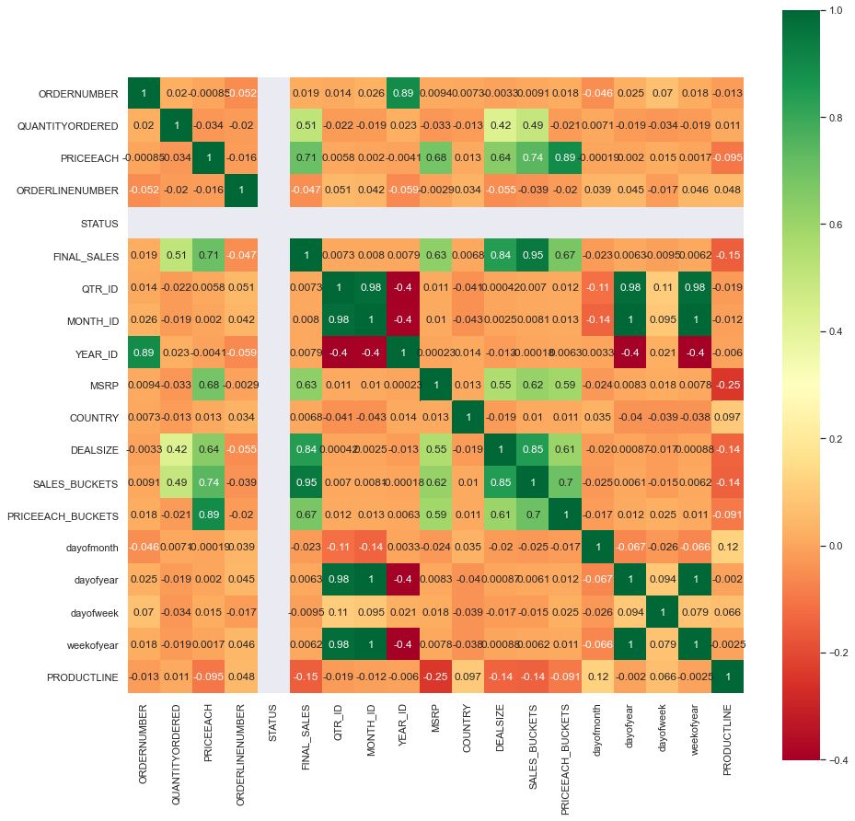
Correlation matrix is formed to understand variable relation among each other.
Key Insights
Using correlation matrix we can say Final Sales is correlated with Quantity, Price, MSRP, deal size, Sales bucket and Price bucket.
Using this information is helpful in understanding linear regression equation.
Source: Car client (2003-2005) financial year $ value

Slide 8
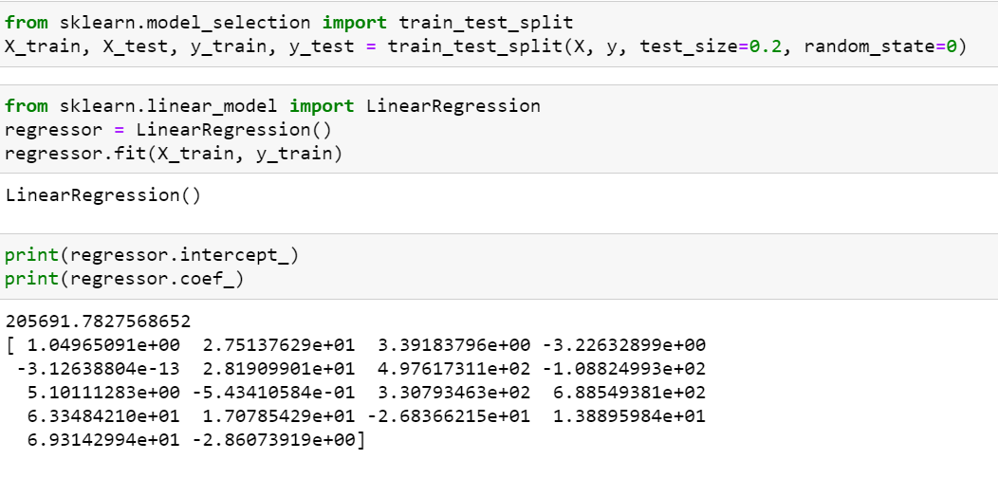
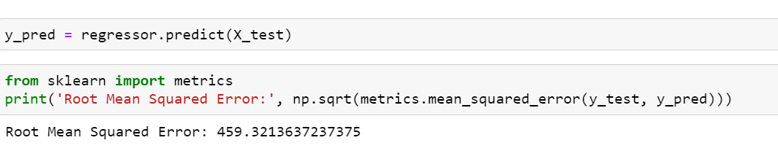
Building a predictive analytics model for sales using linear regression.
Key Insights
The intercept gives value of sales when there no dependent variables to measure.
All the +ve values of coefficients shows linear relationship with sales and –ve coefficients are inverse with sales.
As we saw in earlier the linear relationship variables are Quantity, Price, MSRP, deal size, Sales bucket and Price bucket.
Lower the RMSE better the model performance at real world data.
Source: Car client (2003-2005) financial year $ value

